Slide 1
Distributed Databases
27

Slide 2

Contents
Introduction to distributed processing
Introduction to distributed databases
Distributed Database Design
DBMS vs. Client Server Database

Slide 3
Introduction to distributed processing
In distributed processing, a database’s logical processing is shared among two or more physically independent sites that are connected through a network. For example, the data input/output (I/O), data selection, and data validation might be performed on one computer, and a report based on that data might be created on another computer.

Slide 4
Introduction to distributed databases
A distributed database, on the other hand, stores a logically related database over two or more physically independent sites. The sites are connected via a computer network. In contrast, the distributed processing system uses only a single-site database but shares the processing chores among several sites. In a distributed database system, a database is composed of several parts known as database fragments. The database fragments are located at different sites and can be replicated among various sites. Each database fragment is, in turn, managed by its local database process.

Slide 5
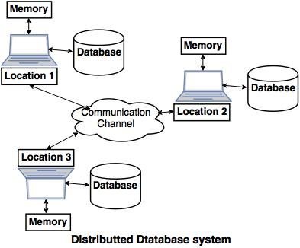
Distributed Databases
A distributed database is a collection of multiple interconnected databases, which are spread physically across various locations that communicate via a computer network

Slide 6
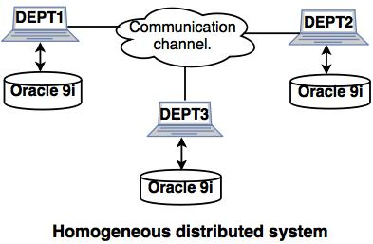
Types of distributed databases
The two types of distributed systems are as follows: 1. Homogeneous distributed databases system: Homogeneous distributed database system is a network of two or more databases (With same type of DBMS software) which can be stored on one or more machines.
So, in this system data can be accessed and modified simultaneously on several databases in the network. Homogeneous distributed system are easy to handle.
Example: Consider that we have three departments using Oracle-9i for DBMS. If some changes are made in one department then, it would update the other department also.

Slide 7
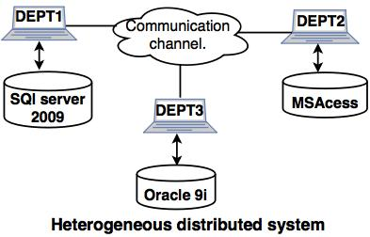
2. Heterogeneous distributed database system
Example: In the following diagram, different DBMS software are accessible to each other using ODBC and JDBC.
Heterogeneous distributed database system is a network of two or more databases with different types of DBMS software, which can be stored on one or more machines.
In this system data can be accessible to several databases in the network with the help of generic connectivity (ODBC and JDBC).

Slide 8
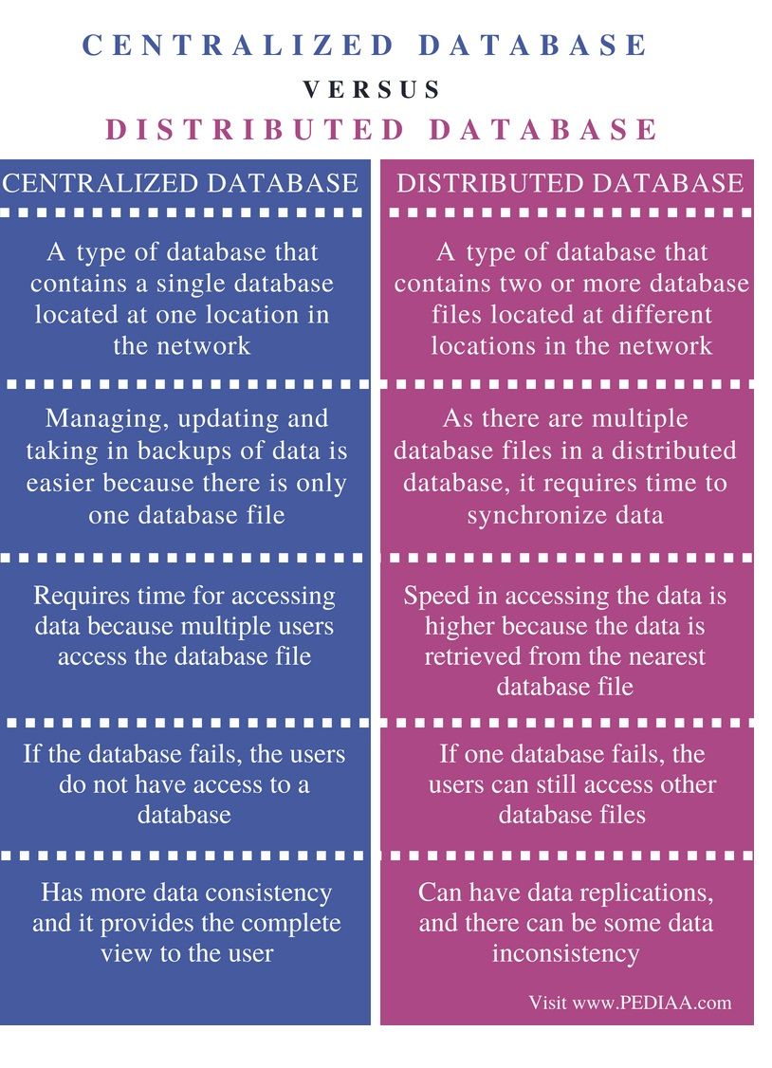

Slide 9


